Slide 1
Tutorial 5
By Jeremy Lim

Slide 2
Testability
Design things to be “testable” – basically deterministic
Given some sequence of inputs, can we always check if we get the expected output?
Inputs can also include function calls to an object

Slide 3
Methods
Exception
Method Arguments
Method
Returned Output
Side Effects
Generally, try not to mix side effects with output
Why? Easier to test if there are fewer possible results.
Spin off another method that is purely side effects and no output and test separately

Slide 4
Methods
Exception
Method Arguments
Method
Returned Output
Side Effects
Example: double divide(int a,int b)
Arguments | Output
1,1 | 1.0
1,2 | 0.5
-1,1 | -1.0
0,100 | 0.0
… | …

Slide 5
Methods
Exception
Method Arguments
Method
Returned Output
Side Effects
Example: double divide(int a,int b)
Arguments | Output
1000,0 | [Exception]
… | …

Slide 6
Methods
Exception
Method Arguments
Method
Returned Output
Side Effects
(increment counter every time divide is called via incrementCounter())
Example: double divide(int a,int b)
Arguments | Output
1,1 | divider.count() == 1
1,1 | divider.count() == 2
1,1 | divider.count() == 3
… | …

Slide 7
Classes
Series of method calls
Class
Final State
Side Effects
Exception

Slide 8
Classes
Series of method calls
Class
Final State
Side Effects
Exception
Goal:
Able to check state (instance variables) for correctness after every method
Individually tested methods

Slide 9
Multiple Classes
Class A
uses
Class B
1. Test cases for B by itself
2. Test cases for A+B, i.e. output from calling methods in A

Slide 10
Anatomy of a test (in testing frameworks)
3 stages: Setup, Tests, Teardown
Setup
Initialise your class to a predefined state specific for that test case or a group of test cases
Test
Actual test itself. Run the code, check results
Teardown
Anything you need to do before you end the test, like close a file or socket
Naming methods: testOnePlusOneEqualsTwo (self descriptive, also processed to use in output)
Overall a decent way to organise tests

Slide 11
Why write test cases? My app is too simple, I can manually test
When you change a few classes that are 5 dependencies down the chain and something breaks
How do you know which class has the problem?
Test cases allow you to identify what broke
Test cases reflect the expected functionality (and should not change after being written)
If you optimise a method, the outputs should not change or something may break

Slide 12
Q1: Fraction math
Write a Fraction class
Methods
Add, subtract, divideBy, multiply (with another fraction)
Simplify (Return simplest form)
Numerator, denominator
Equals, toString
All instance fields are private and final (class is immutable)
Static constants ZERO and ONE (that are Fractions)

Slide 13
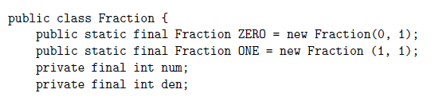
Basics

Slide 14
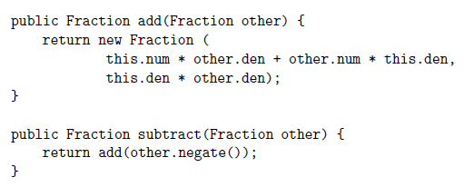
Add, subtract, multiply, divide

Slide 15

Simplify (We skip the uninteresting ones)
What we know about fractions: $\frac{a}{b}=\frac{cx}{cy}=\frac{x}{y}$
$\frac{a}{b}$ is simplified to $\frac{x}{y}$ by dividing by some common factor $c$
Specifically, $c$ is the greatest common factor of $a$ and $b$
How to find? Euclid’s Algorithm

Slide 16
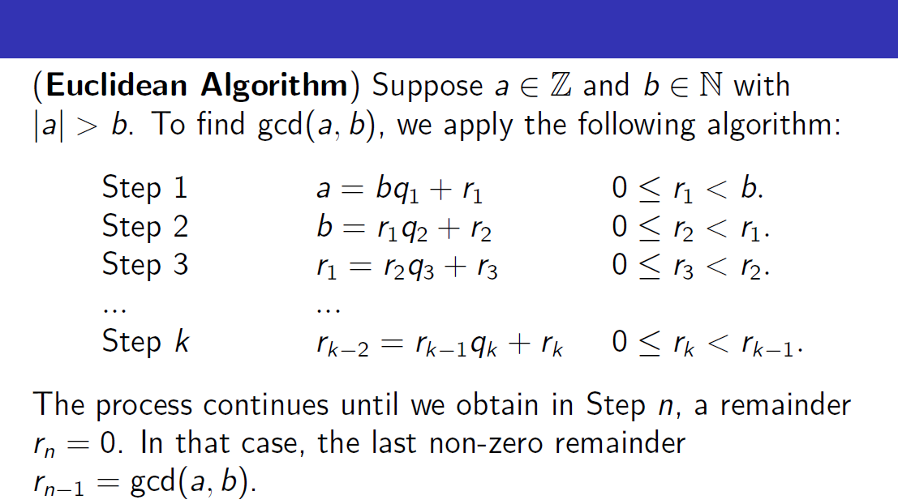
(Stolen from GET1004)

Slide 17
Note on equals()
When you override equals(), override hashCode() as well
a.equals(b) -> a.hashCode() == b.hashCode()
But other way round is not necessary!
Why? Required for functionality of HashMap and HashSet (commonly used data structures) – Learn more in CS2040

Slide 18
Q2: Burger class design
Burgers of different types with combinations of bun, vege, patty represented by Strings
Burger A with 4 constructors
(String bun), (String bun, String vegetable), (String bun, String patty), (String bun, String patty, String vegetable)
Burger B, constructor takes bun, methods to set patty and vege
What’s wrong with each of them?

Slide 19
Q2: Burger class design
Burgers of different types with combinations of bun, vege, patty represented by Strings
Burger A with 4 constructors
(String bun), (String bun, String vegetable), (String bun, String patty), (String bun, String patty, String vegetable)
Burger B, constructor takes bun
Method patty(String) to set patty, vegetable(String) to set vegetable
What’s wrong with each of them?
A: has 2 constructors that are the same
B: Hard to create. (Cannot chain methods)

Slide 20
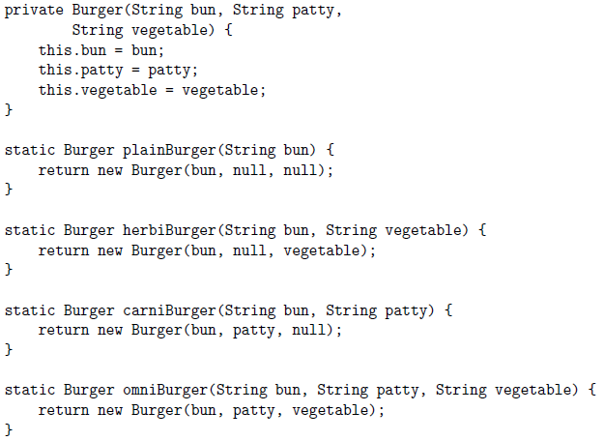
How to design?
Trying to enforce constraints in constructor
As we learnt from a previous tutorial, use static method and private constructor!

Slide 21
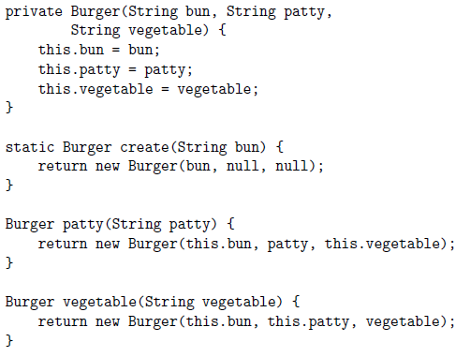
Q2b: Method chaining
Idea: create(bun) creates a Burger with null patty and vege
Patty and vegetable methods copy data from current burger to create a new one

Slide 22
Q2c: Replace null with Optional in b
Optional: Might contain a value
When print(optional.orElse(“somethingElse”)), if optional has a value then it would be taken, otherwise value of orElse will be taken.
Optional.of(value) to store a value. If value == null, then Optional.empty() is true

Slide 23
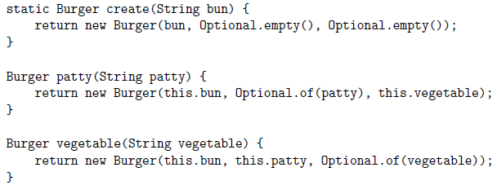

Slide 24
